Slide 1
Software Engineering - Group 4
Ben, Josh, Craig, Yifan, Rob

Slide 2
Group Dynamics
Roles:
Craig – Scrum Master/Dev Team
Ben – Product Owner/Dev Team
Josh – Dev Team
Yifan – Dev Team
Rob – Dev Team

Slide 3
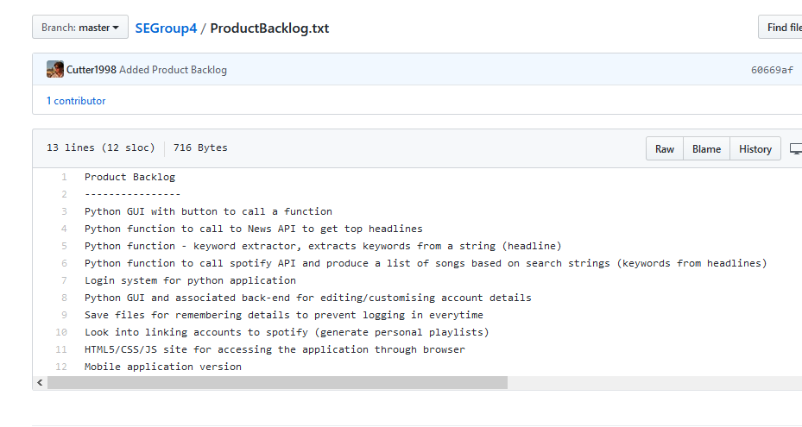
Our Sprint

Slide 4
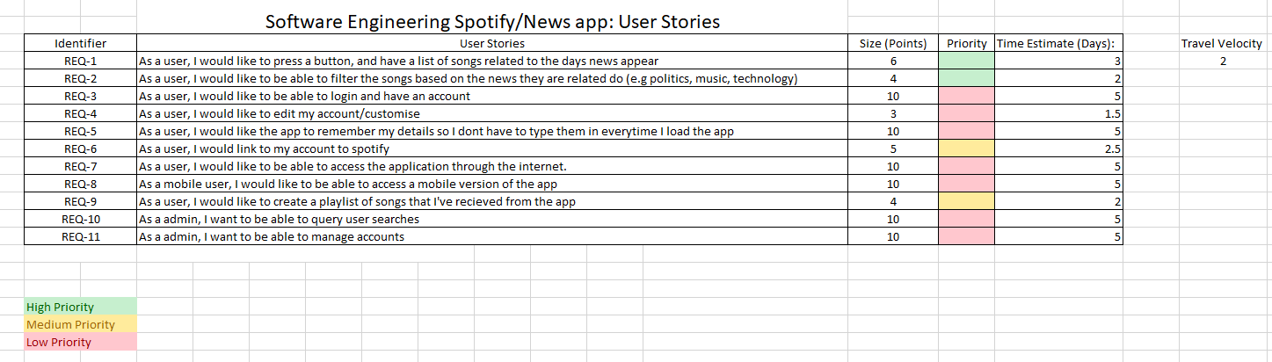
OUR SPRINT

Slide 5
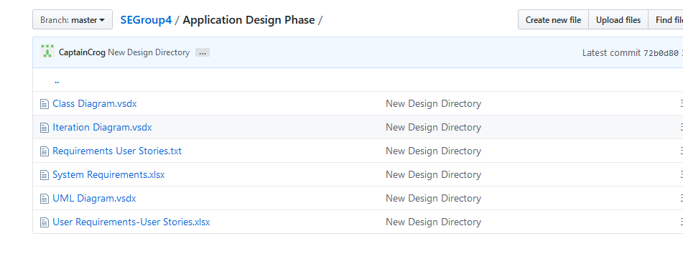
Our Sprint

Slide 6
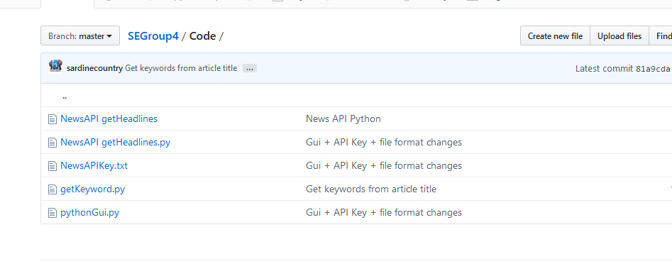
Our Sprint

Slide 7



Tools and Toolsets
Communication –
Version Control –
Storage/Management -

Slide 8
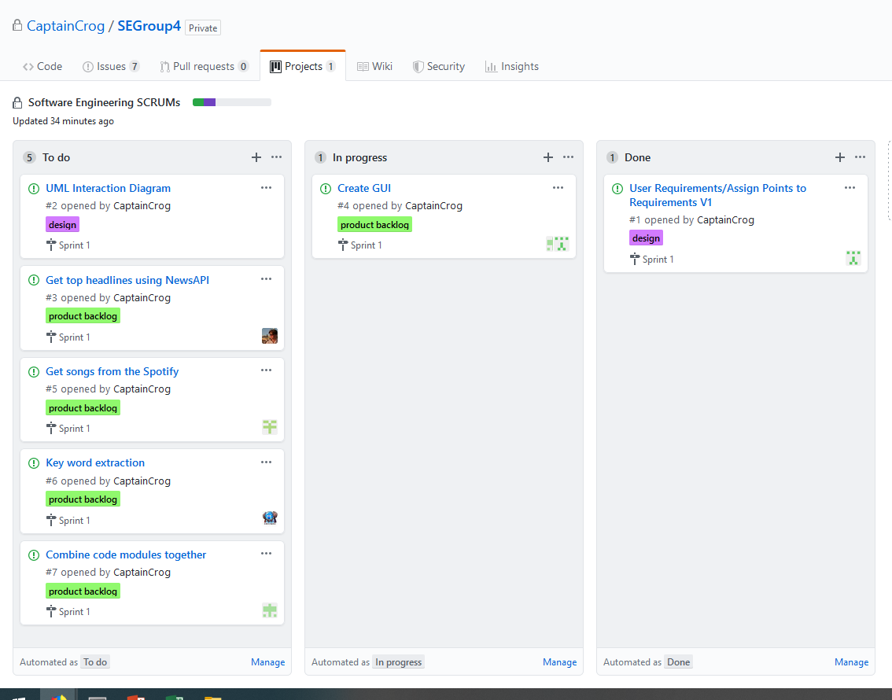
Evaluation
How is our sprint being managed?

Slide 9
Evaluation
In summary, our first sprint has gone reasonably well.
In the next sprint we need to focus on producing work more consistently at a higher frequency to ensure we meet our end goals.
We also need to make sure we understand the user requirements more fully. A lot of assumptions were made in our first Sprint that were unnecessary as we could’ve just asked our clients.
We should invest in spending time creating branches for the GitHub repo with each collaborator’s work to avoid file conflicts

Slide 10
Thank you for listening.
Are there any questions?

